Slide 2
What Makes For a Great Small Group Experience?

Slide 3
What Makes For a Great Small Group Experience?

Slide 4
Small Group Ministry is part of the purpose or mission of the church- to make disciples of Jesus Christ

Slide 6
The Great Ommission

Slide 7
The Great Ommission
The Three C’s Needed

Slide 8
The Great Commission
The Three C’s Needed
The Conviction that Jesus is Lord and Savior

Slide 9
The Great Commission
The Three C’s Needed
The Conviction that Jesus is Lord and Savior
The Concern for the spiritual needs of people

Slide 10
The Great Commission
The Three C’s Needed
The Conviction that Jesus is Lord and Savior
The Concern for the spiritual needs of people
The Consecration of resources
* Missionary to India, John T. Seamands, Tell It Well

Slide 11
Acts 2:42-47
⁴² They devoted themselves to the apostles’ teaching and to fellowship, to the breaking of bread and to prayer. ⁴³ Everyone was filled with awe at the many wonders and signs performed by the apostles.

Slide 12
⁴⁴ All the believers were together and had everything in common. ⁴⁵ They sold property and possessions to give to anyone who had need. ⁴⁶ Every day they continued to meet together in the temple courts.

Slide 13
They broke bread in their homes and ate together with glad and sincere hearts, ⁴⁷ praising God and enjoying the favor of all the people. And the Lord added to their number daily those who were being saved.

Slide 14
Dimensions of Church Life Present
Discipleship & Apostles’ Teaching
Prayer & Worship
Fellowship & Sharing in Community
Outreach & Evangelism

Slide 15
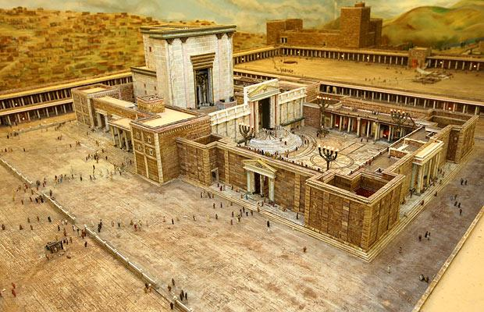
Fellowship & Community and Discipleship/Teaching
“Every day they continued to meet in the temple courts…”
“They broke bread
in their homes…”

Slide 16
Acts 5:42
⁴² Day after day, in the temple courts and from house to house, they never stopped teaching and proclaiming the good news that Jesus is the Messiah.

Slide 17
Small Group Community Life in the Bible
Jesus’ ministry with the twelve
Jesus’ ministry in people’s homes
Jesus’ sending out the disciples to homes
The many “one another” passages
“Oikos” – households of faith in NT
House church networks- ex. Aquila and Priscilla, Rom 16:3-5

Slide 18
Early Church Small Groups & Neighborhood Small Groups
Laity led discussions, typically sermon-based
Focuses on life application of the scriptures and sermons
Usually meets in homes
Natural means of both evangelism and discipleship within group setting
Unlimited potential growth, reproducible model

Slide 19
“Cell Church” - Beginnings of the Modern Movement
1970’s- Yoido Full Gospel Church in Seoul, Korea
Rev. David Cho
2,400 members

Slide 20
“Cell Church” - the Modern Movement
Yoido Full Gospel Church in Seoul, Korea today
25,000 cells
250,000 in attendance
850,000 members

Slide 21
John Ortberg, “The Me I Want To Be”
“God uses people to form people. That is why what happens between you and another person is never merely human-to-human interaction- the Spirit longs to be powerfully at work in every encounter.”

Slide 22
A Relational Approach to Discipleship & Evangelism
The Setting –
The Focus –

Slide 23
A Relational Approach to Discipleship & Evangelism
The Setting –
social & relational Christian hospitality
interactive and conversational learning

Slide 24
A Relational Approach to Discipleship & Evangelism
The Focus –
Applying the weekly messages and scriptures to daily life, growth in discipleship is central (Acts 5:42)
Focus shift from participant to leader = Personal growth → growth of others

Slide 25
Hurdles in Getting Started
Is This Above My Paygrade?

Slide 26
Hurdles in Getting Started
Is This Above My Paygrade?
Priesthood of all believers – 1 Peter 2:9 “But you are a chosen people, a royal priesthood, a holy nation, God’s special possession, that you may declare the praises of him who called you out of darkness into his wonderful light.

Slide 27
Hurdles in Getting Started
Is This Above My Paygrade?
Priesthood of all believers – 1 Peter 2:9 “But you are a chosen people, a royal priesthood, a holy nation, God’s special possession, that you may declare the praises of him who called you out of darkness into his wonderful light.
Getting Organized

Slide 28
Hurdles in Getting Started
Is This Above My Paygrade?
Priesthood of all believers – 1 Peter 2:9 “But you are a chosen people, a royal priesthood, a holy nation, God’s special possession, that you may declare the praises of him who called you out of darkness into his wonderful light.
Getting Organized
Fear

Slide 29
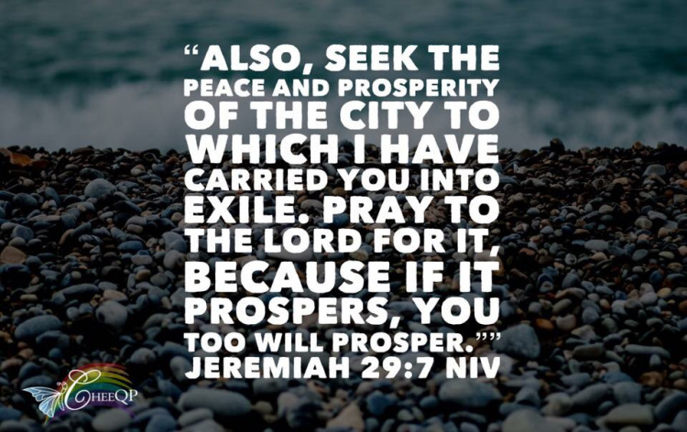
Christ Church’s Missional Focus 2017

Slide 30
⁴ This is what the Lord Almighty, the God of Israel, says to all those I carried into exile from Jerusalem to Babylon: ⁵ “Build houses and settle down; plant gardens and eat what they produce. ⁶ Marry and have sons and daughters; find wives for your sons and give your daughters in marriage, so that they too may have sons and daughters. Increase in number there; do not decrease. ⁷

Slide 31
Also, seek the peace and prosperity of the city to which I have carried you into exile. Pray to the Lord for it, because if it prospers, you too will prosper.”⁸ Yes, this is what the Lord Almighty, the God of Israel, says: “Do not let the prophets and diviners among you deceive you. Do not listen to the dreams you encourage them to have.⁹ They are prophesying lies to you in my name. I have not sent them,” declares the Lord.

Slide 32
¹⁰ This is what the Lord says: “When seventy years are completed for Babylon, I will come to you and fulfill my good promise to bring you back to this place. ¹¹ For I know the plans I have for you,” declares the Lord, “plans to prosper you and not to harm you, plans to give you hope and a future. ¹² Then you will call on me and come and pray to me, and I will listen to you.

Slide 33
¹³ You will seek me and find me when you seek me with all your heart. ¹⁴ I will be found by you,” declares the Lord, “and will bring you back from captivity. I will gather you from all the nations and places where I have banished you,” declares the Lord, “and will bring you back to the place from which I carried you into exile.”

